Slide 1
Quick Intro to Graphing Motion

Slide 2
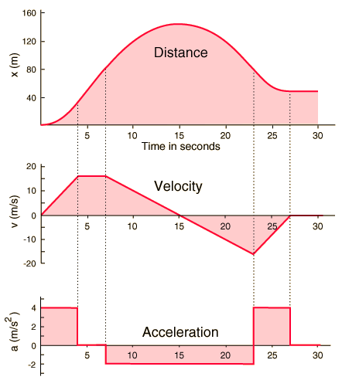

Slide 3
